Slide 1

Introduction to Elyra:
AI-centric extensions to JupyterLab Edward Leardi Saishruthi Swaminathan Yiwen Li
http://bit.ly/pycon_elyra

Slide 2






About us
IBM – Center for Open Source Data and AI Technologies (CODAIT)
Yiwen Li
Data Scientist
Edward Leardi
Data Scientist
Saishruthi Swaminathan
Developer Advocate & Data Scientist
Yiwen.Li@ibm.com
github.com/yil532
linkedin.com/in/yiwenli
edward@ibm.com
github.com/edwardleardi
linkedin.com/in/edwardleardi
saishruthi.tn@ibm.com
https://github.com/SSaishruthi
https://www.linkedin.com/in/saishruthi-swaminathan/
© 2020 IBM Corporation
http://bit.ly/pycon_elyra

Slide 3
Overview
What is CODAIT?
An overview of the Data Asset eXchange (DAX)
A deep dive into Elyra and its features
Demo showcasing DAX & Elyra
How to get involved
© 2020 IBM Corporation
http://bit.ly/pycon_elyra

Slide 4

Center for Open Source Data & AI Technologies
CODAIT
Open Source @ IBM
codait.org
Improving the Enterprise AI Lifecycle in Open Source
CODAIT aims to make AI solutions dramatically easier to create, deploy, and manage in the enterprise.
We contribute to and advocate for the open-source technologies that are foundational to IBM’s AI offerings.
30+ open-source developers!
© 2020 IBM Corporation
http://bit.ly/pycon_elyra

Slide 5

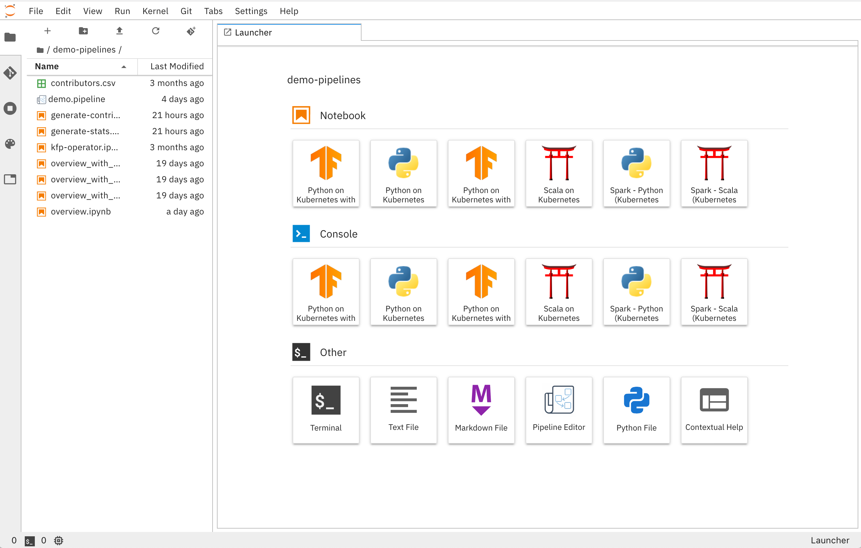
What is Elyra?
Elyra on GitHub
https://github.com/elyra-ai/elyra
Elyra's Documentation
https://elyra.readthedocs.io/en/latest/
Elyra is a set of AI centric extensions to JupyterLab. It aims to help data scientists, machine learning engineers and AI developer’s through the model development life cycle complexities.
http://bit.ly/pycon_elyra
© 2020 IBM Corporation
Notes:
~ 1:20min
Thanks Saishruthi.
So what exactly is Elyra? Well at its core, Elyra is simply a set of JupyterLab extensions catered to people who like to work with AI and ML using notebooks… Elyra’s goal is to help data scientists, machine learning engineers, and AI developer’s through the most common model development life cycle complexities. Elyra boasts a host of features to achieve this goal which we will discuss shortly, but for now what I want you to takeaway from the screenshot here on the right, is that Elyra doesn’t radically reinvent JupyterLab to provide you with all of these enhanced functionalities. It simply extends the distinct JupyterLab IDE environment that we’ve all come to know love over the years, with added tabs, toolbars and launchers.
Elyra was officially announced as an open source project by IBM this past April. If you would like to access the GitHub repo or the docs, you can follow the links we’ve shared here on screen.
Oh, and in case you’re curious where the name of the extension comes from, it’s a play on the word Elara… So Elara is one of Jupiter, the planet’s, moons, and Elyra is simply the first “a” replaced with a “y” just like in Jupyter, the project.

Slide 6
What is Elyra?
Elyra is a set of AI centric extensions for JupyterLab
Elyra was officially announced as an open source project by IBM on April 29th.
The name Elyra is a word play with one of the Jupyter moons “Elara” where we introduce the “y” from “Jupyter” to make it “Elyra”
http://bit.ly/pycon_elyra

Slide 7
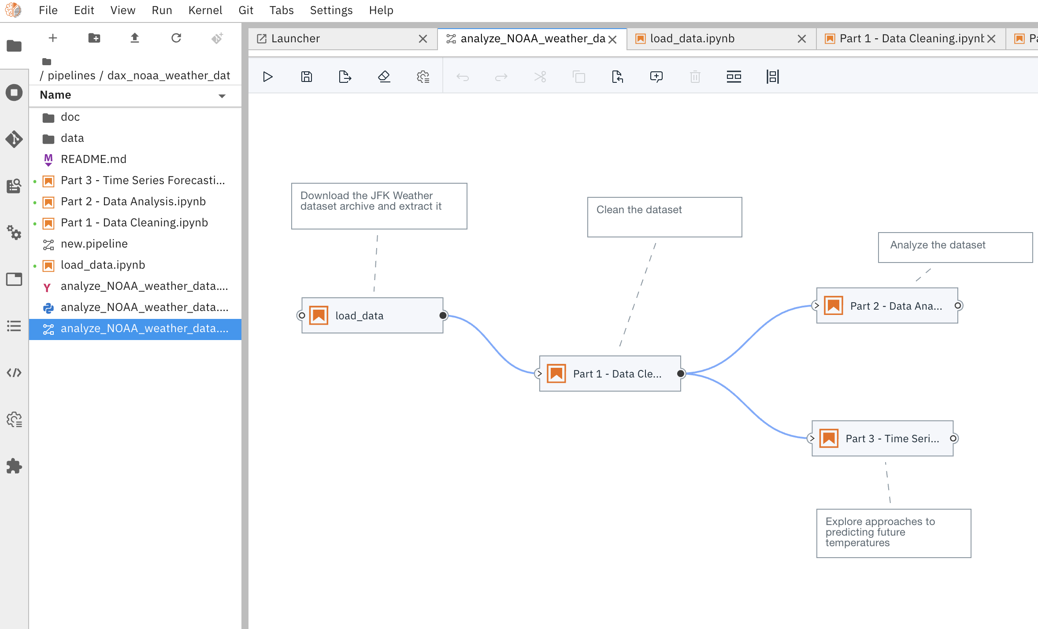
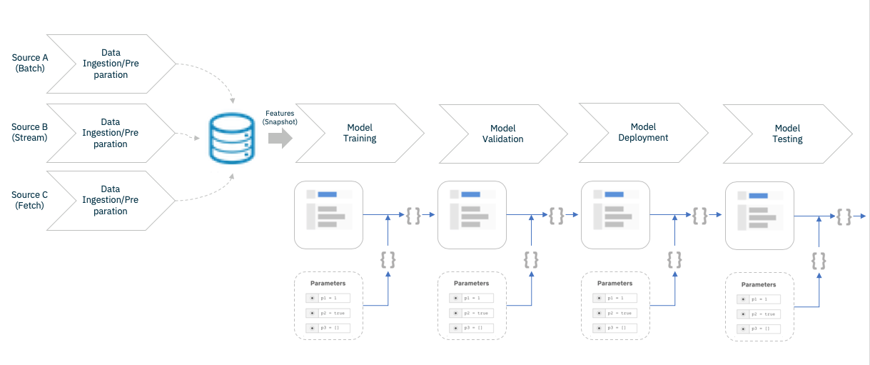
Elyra Core Features
Notebook Pipelines
Notebook Pipelines editor
Visual editor for building notebook-based AI pipelines, enabling the conversion of multiple notebooks into batch jobs or workflows.
Notebook as batch jobs
Elyra extends the notebook UI to simplify the submission of notebooks as a batch job for model training
Code Snippets
Easy creation and insertion of reusable code snippets for the various languages
Git integration
Track project changes and share among teammates
Python script execution
Edit and execute python scripts against local or cloud-based resources
© 2020 IBM Corporation
http://bit.ly/pycon_elyra

Slide 8
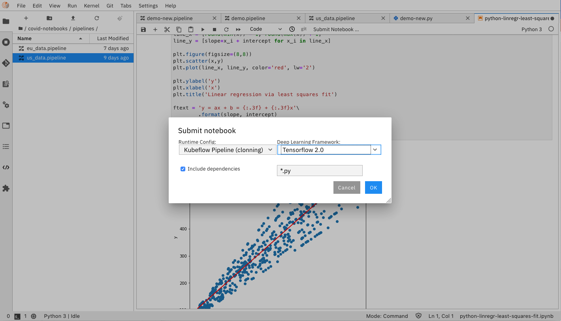
Elyra Core Features
Notebook as batch jobs
Notebook Pipelines editor
Visual editor for building notebook-based AI pipelines, enabling the conversion of multiple notebooks into batch jobs or workflows.
Notebook as batch jobs
Elyra extends the notebook UI to simplify the submission of notebooks as a batch job for model training
Code Snippets
Easy creation and insertion of reusable code snippets for the various languages
Git integration
Track project changes and share among teammates
Python script execution
Edit and execute python scripts against local or cloud-based resources
© 2020 IBM Corporation
http://bit.ly/pycon_elyra

Slide 9
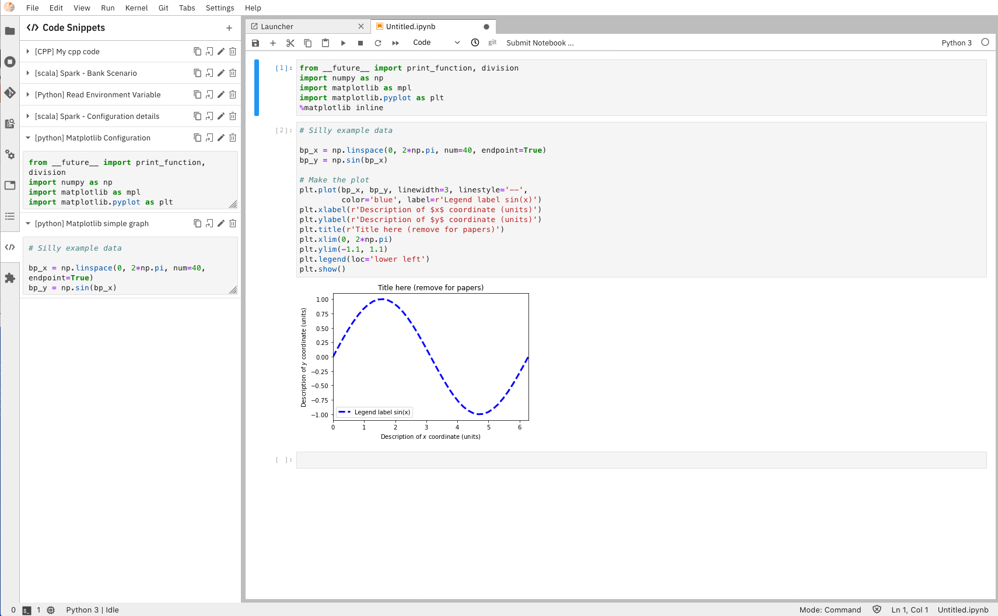
Elyra Core Features
Code Snippets
Notebook Pipelines editor
Visual editor for building notebook-based AI pipelines, enabling the conversion of multiple notebooks into batch jobs or workflows.
Notebook as batch jobs
Elyra extends the notebook UI to simplify the submission of notebooks as a batch job for model training
Code Snippets
Easy creation and insertion of reusable code snippets for the various languages
Git integration
Track project changes and share among teammates
Python script execution
Edit and execute python scripts against local or cloud-based resources
© 2020 IBM Corporation
http://bit.ly/pycon_elyra

Slide 10
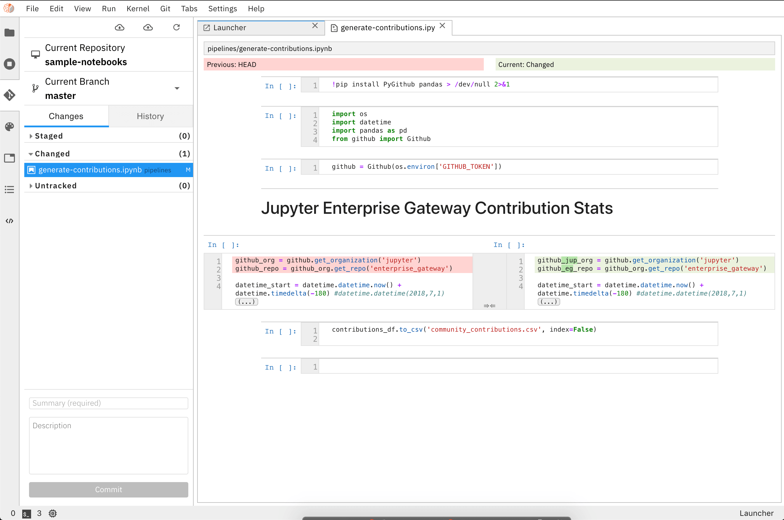
Elyra Core Features
Notebook Pipelines editor
Git integration
Visual editor for building notebook-based AI pipelines, enabling the conversion of multiple notebooks into batch jobs or workflows.
Notebook as batch jobs
Elyra extends the notebook UI to simplify the submission of notebooks as a batch job for model training
Code Snippets
Easy creation and insertion of reusable code snippets for the various languages
Git integration
Track project changes and share among teammates
Python script execution
Edit and execute python scripts against local or cloud-based resources
© 2020 IBM Corporation
http://bit.ly/pycon_elyra

Slide 11
Elyra Core Features
Notebook Pipelines editor
Python Script editor
Visual editor for building notebook-based AI pipelines, enabling the conversion of multiple notebooks into batch jobs or workflows.
Notebook as batch jobs
Elyra extends the notebook UI to simplify the submission of notebooks as a batch job for model training
Code Snippets
Easy creation and insertion of reusable code snippets for the various languages
Git integration
Track project changes and share among teammates
Python script execution
Edit and execute python scripts against local or cloud-based resources
© 2020 IBM Corporation
http://bit.ly/pycon_elyra

Slide 12
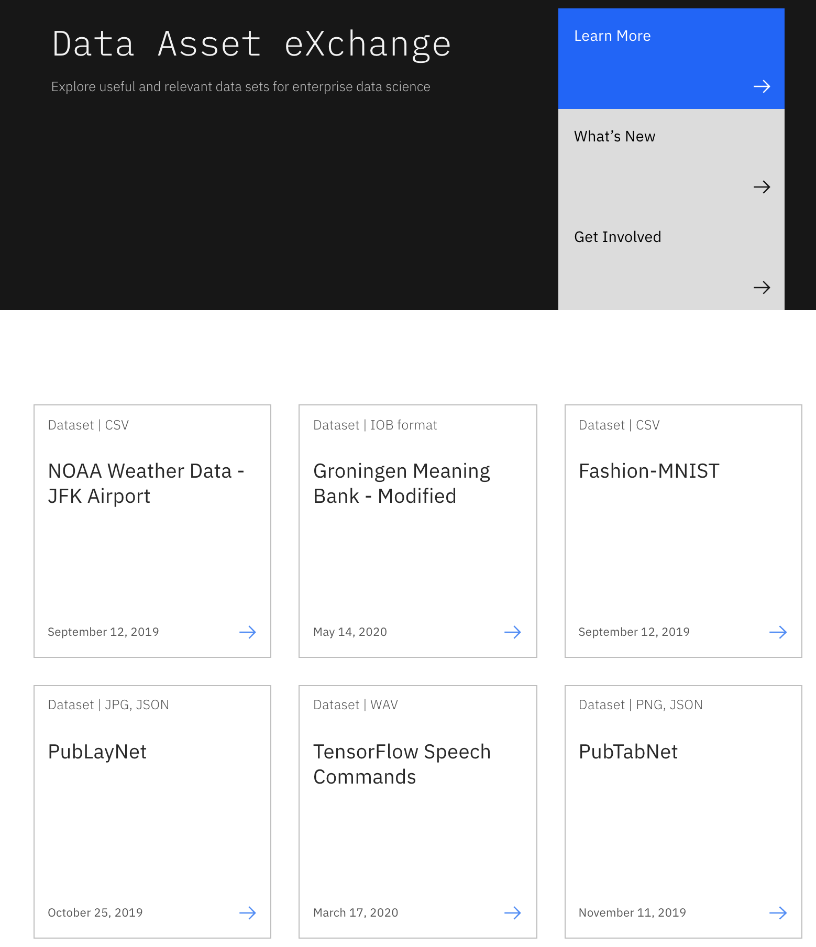
Data Asset eXchange
Data Asset Exchange offers high-quality datasets with clearly-defined open data licenses in standardized formats, according to IBM.
Vetted data.
Exclusive access to IBM Research datasets that have been used in creating popular AI products like Debater System, Entity Recognition, and so on.
Datasets with open data licenses for both business applications and advancing core science.
Packaged with tutorials that shows how to read and analyze data. As well as, train machine or deep learning models on IBM Cloud using IBM Cloud AI services as well as multi-cloud AI open-sourced tools.
ibm.biz/data-exchange
http://bit.ly/pycon_elyra
© 2020 IBM Corporation

Slide 13
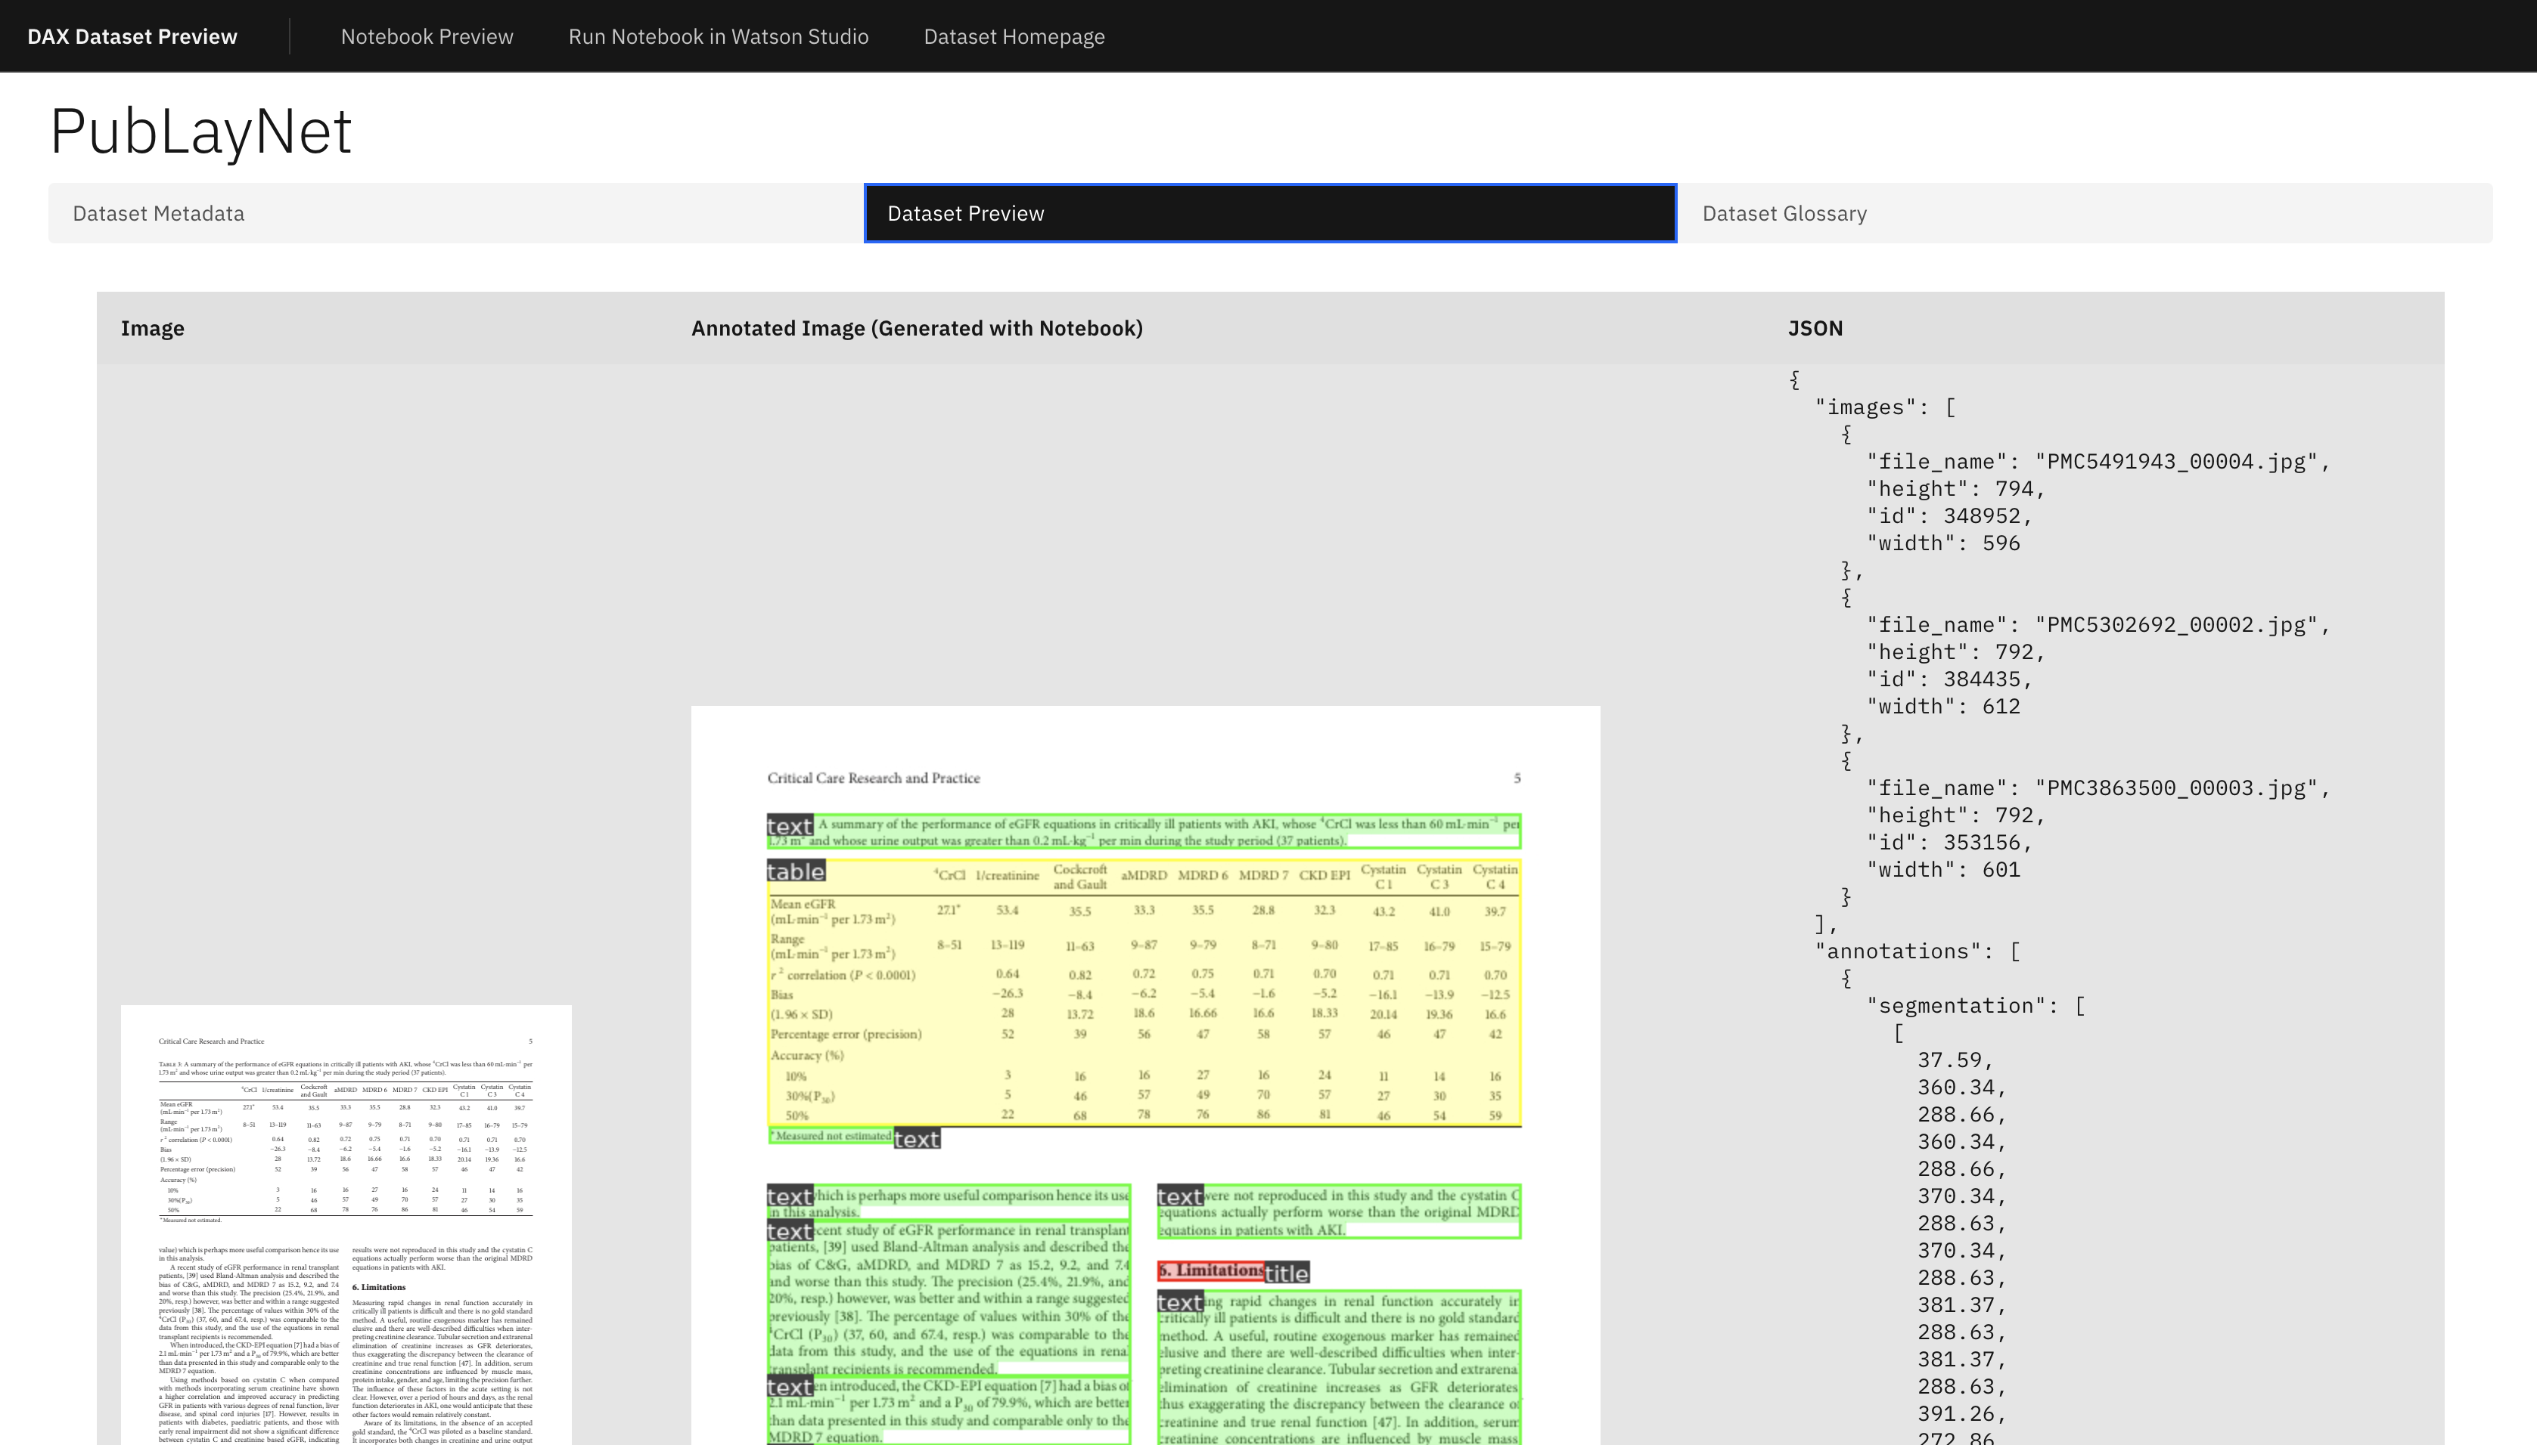
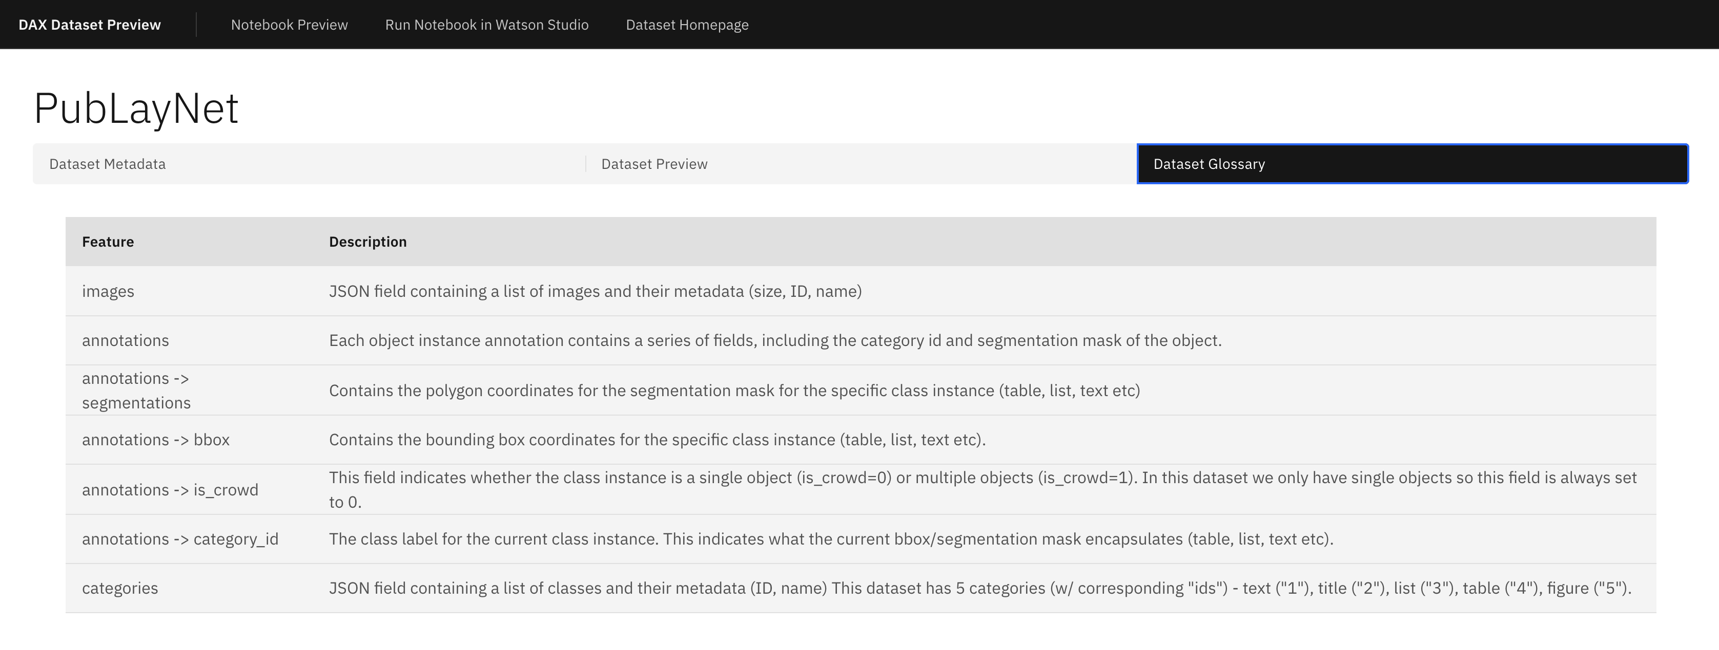
Data Preview and Data Glossary
http://bit.ly/pycon_elyra

Slide 14
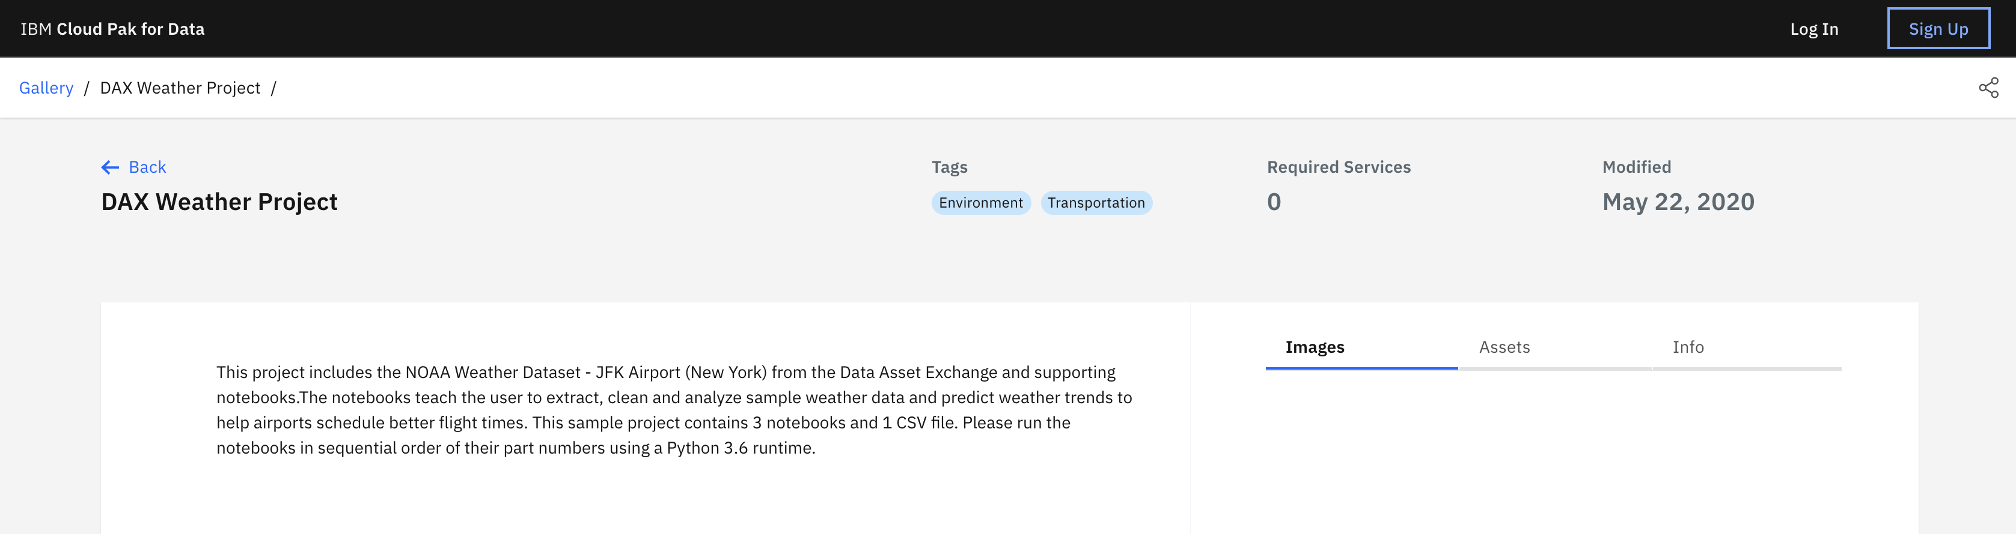
Access notebook in Watson Studio
http://bit.ly/pycon_elyra

Slide 15
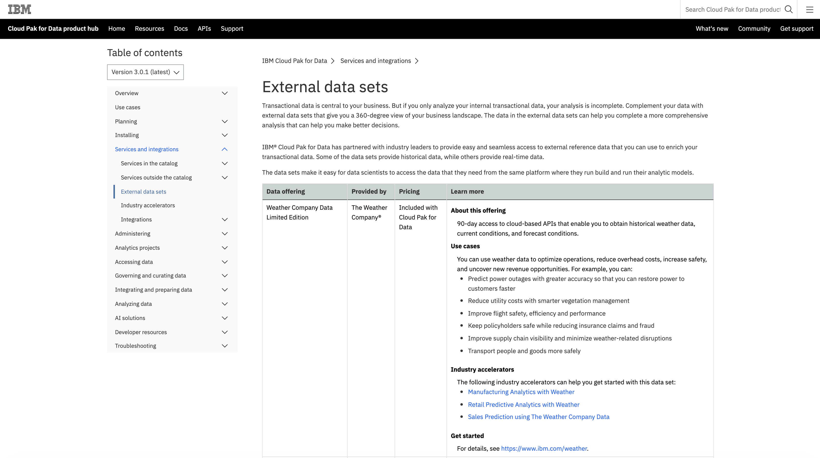
Access from Cloud Pak for Data
https://www.ibm.com/support/producthub/icpdata/docs/content/SSQNUZ_current/svc-nav/data-sets.html
http://bit.ly/pycon_elyra

Slide 16
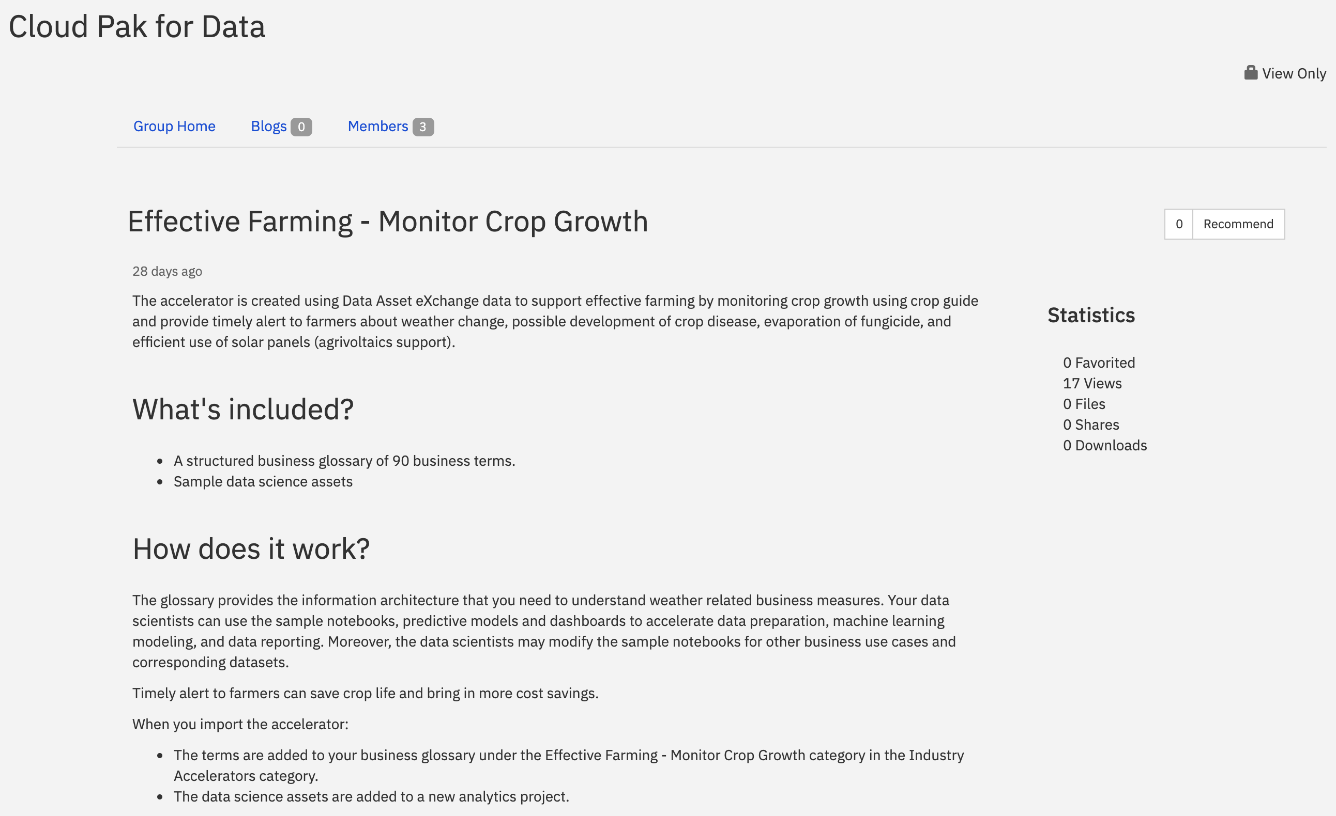
Industrial Accelerator - Cloud Pak for Data
https://community.ibm.com/community/user/cloudpakfordata/viewdocument/effective-farming-monitor-crop-gr
http://bit.ly/pycon_elyra

Slide 17
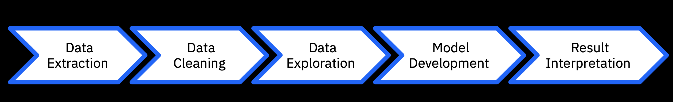
Data Science Process
© 2020 IBM Corporation
http://bit.ly/pycon_elyra

Slide 18
Getting Started
What are the pre-requisites to run?
NodeJS 12+
Python 3.X
Anaconda (optional)
JupyterLab Support
JupyterLab 1.X is supported on Elyra 0.10.x and below
JupyterLab 2.X is supported on Elyra 1.0.0 and above
KubeFlow Installation (optional)
© 2020 IBM Corporation
http://bit.ly/pycon_elyra

Slide 19
Install Elyra
To install Elyra: $ pip install elyra==1.1.0 && jupyter lab build Or: $ pip install --upgrade elyra && jupyter lab build
To verify installation: $ jupyter serverextension list And $ jupyter labextension list
Starting Elyra:
$ jupyter lab
© 2020 IBM Corporation
http://bit.ly/pycon_elyra

Slide 20

© 2020 IBM Corporation
http://bit.ly/pycon_elyra

Slide 21
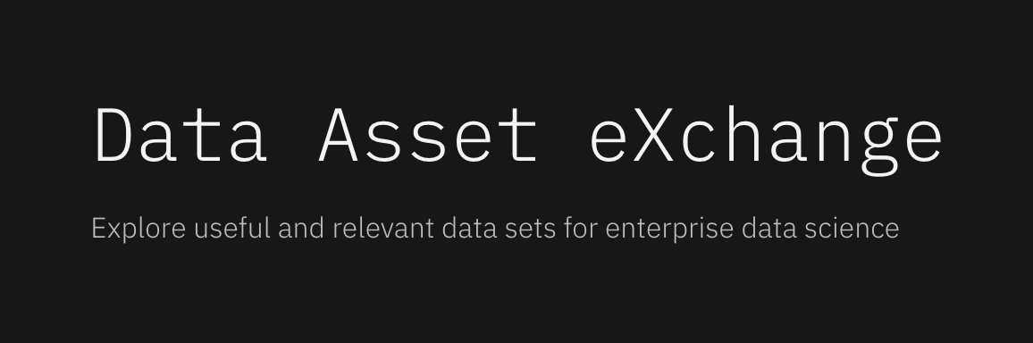
Get involved
Getting started with Elyra
https://elyra.readthedocs.io/en/latest/getting_started/installation.html
Elyra’s Github
https://github.com/elyra-ai/elyra
Data Asset eXchange
https://developer.ibm.com/exchanges/data/
DAX notebooks Github
https://github.com/elyra-ai/examples/tree/master/pipelines/dax_noaa_weather_data
Contributing to these projects
Bug reports
Enhancement requests
Code reviews
© 2020 IBM Corporation
http://bit.ly/pycon_elyra

Slide 22
Related Links
Slides: http://bit.ly/pycon_elyra
Elyra Github: https://github.com/elyra-ai/elyra
DAX Asset eXchange: http://ibm.biz/data-exchange
Elyra demo Github: https://github.com/elyra-ai/examples/
Sign up for IBM Cloud: https://ibm.biz/BdqVxW
Model Asset eXchange: http://ibm.biz/model-exchange
© 2020 IBM Corporation
http://bit.ly/pycon_elyra

Slide 23
© 2020 IBM Corporation
http://bit.ly/pycon_elyra

